Slide 1
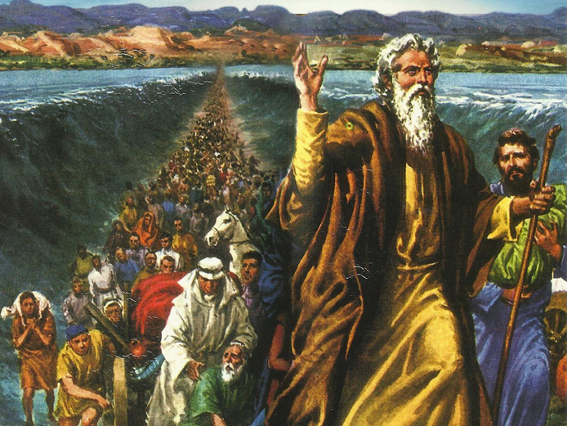
CATECHETICAL TEXTBOOK SERIES OF THE SYRO - MALABAR CHURCH
ON THE PATH OF SALVATION - 5
PEOPLE WHO AWAITED THE REDEEMER
5

Slide 2
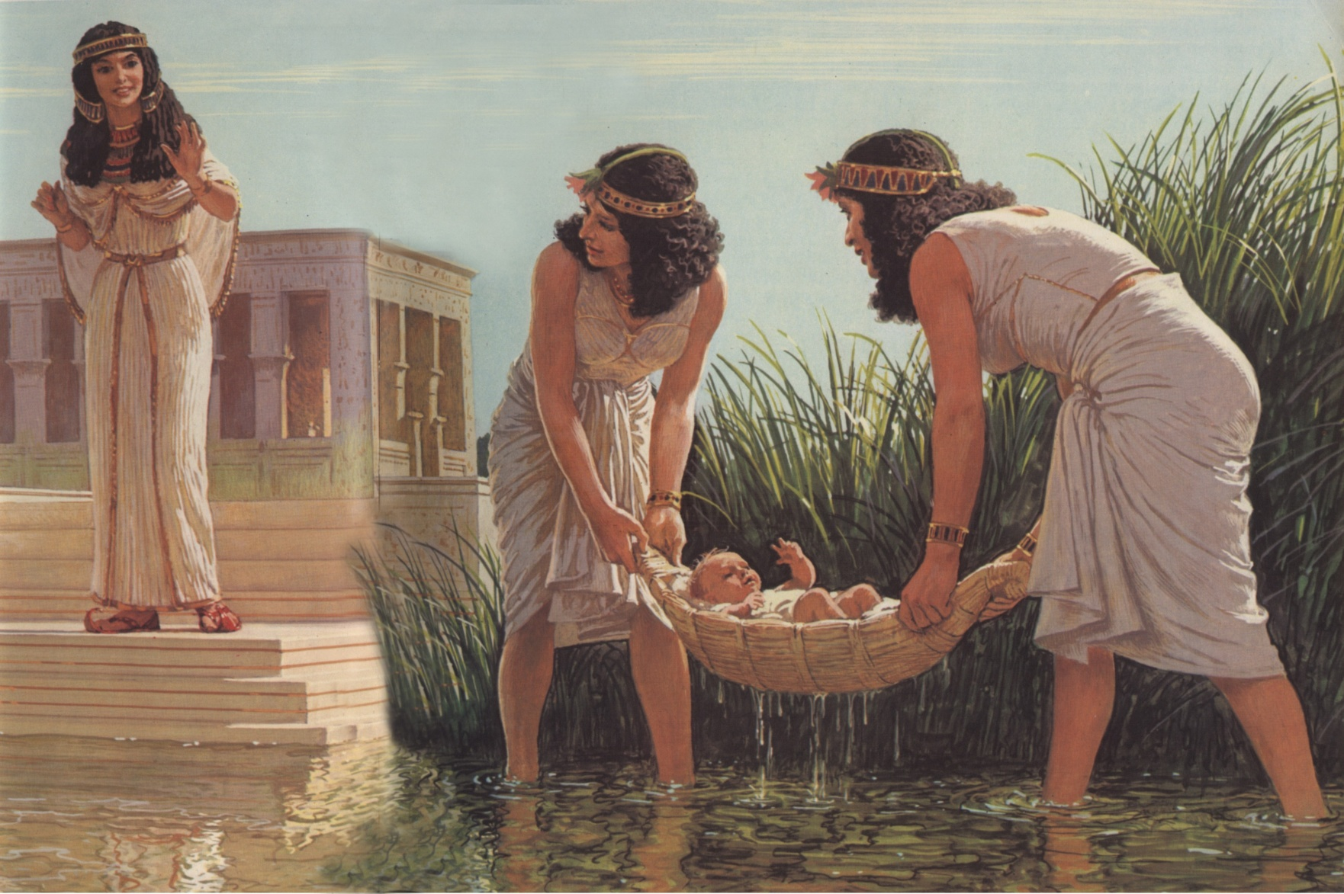
LESSON 5
MOSES THE LIBERATOR

Slide 3
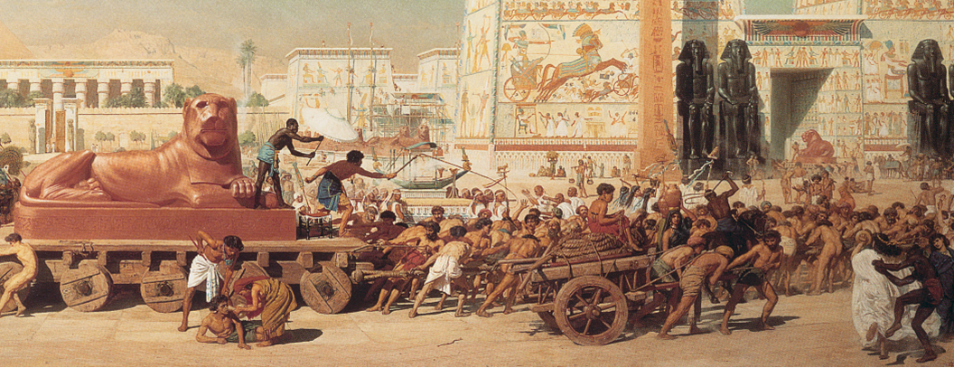
Israel lived in Egypt a long time not a few years but four centuries. In the early period, the Egyptians respected them because of Joseph. But later they Hated the people of Israel who in the course of time spread over the whole of the land and amassed wealth and became strong. So they began to crush Israel. The Pharaoh of that time consented to this.
This is described clearly in Exodus, the second book of Old Testament.

Slide 4
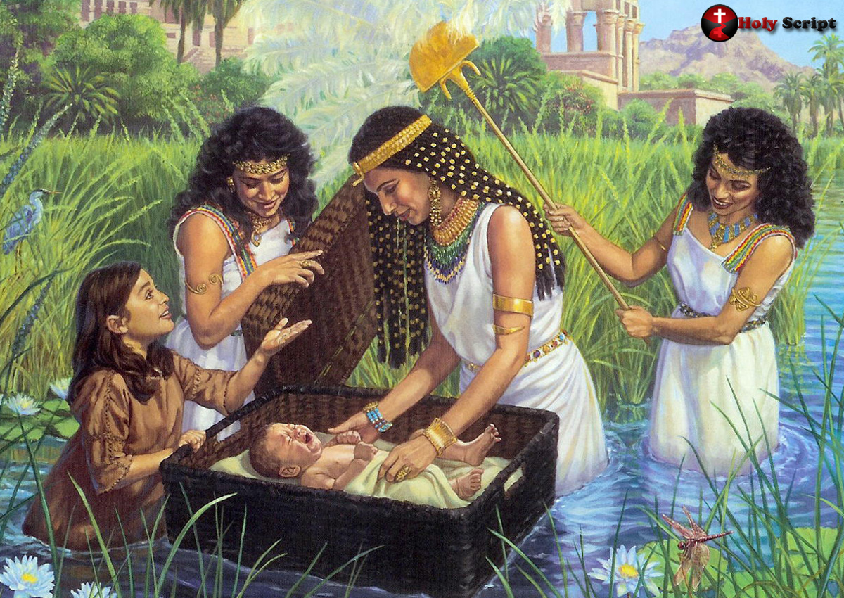
The birth of moses
The pharaoh decreed that all the male children born in the Israel families must be killed. Many newborn babies were killed accordingly. But one Israeli mother not wishing her son to be killed brought him up in secrecy. When the boy was three month old and no more possible to be brought up in secrecy, she made a basket of papyrus lined with bitumen and pitch for water proofing, put the baby in this and left the basket with the baby among the reeds in the river Nile.

Slide 5
The daughter of the Pharaoh saw this baby in a basket among the reeds as she was going down to bathe at the river. She decided to bring up the boy as her own son. This princess wanted someone to look after the baby and the real mother of the child offered to do that for her. After its childhood the boy was returned to the princess and she called him Moses, which means ‘taken from water’. There he lived in the royal palace as one of the princes.

Slide 6
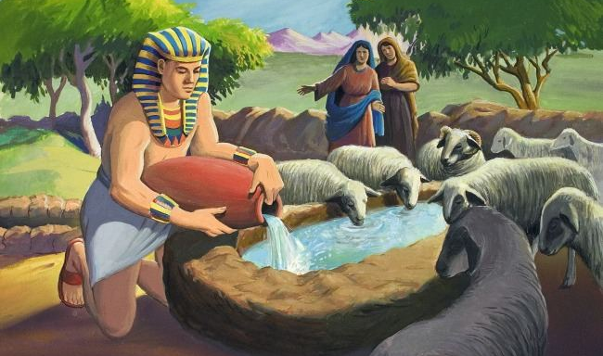
Moses flees from egypt
Moses grew up in the palace as a prince of Egypt. But he was aware that hr was a Hebrew (Israelite). After reaching adulthood once he went to see his people. He saw with his own eyes the sufferings that his people were subjected to. When he saw an Egyptian overseer beating an Israelite, he got angry and killed that Egyptian. Learning of this the Pharaoh Decided to punish Moses. But Moses fled from Egypt and reached the land of Midian. There he worked as the shepherd of the priest Jethro. Later, he married Jethro’s daughter.

Slide 7
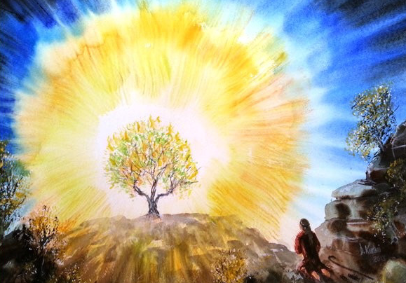
God calls moses
“ Come no closer! Remove the sandals from your feet, for the place on which you are standing is holy ground. I am the God of your father; the father of Abraham, Isaac and Jacob” (Ex.3:5-6).

Slide 8
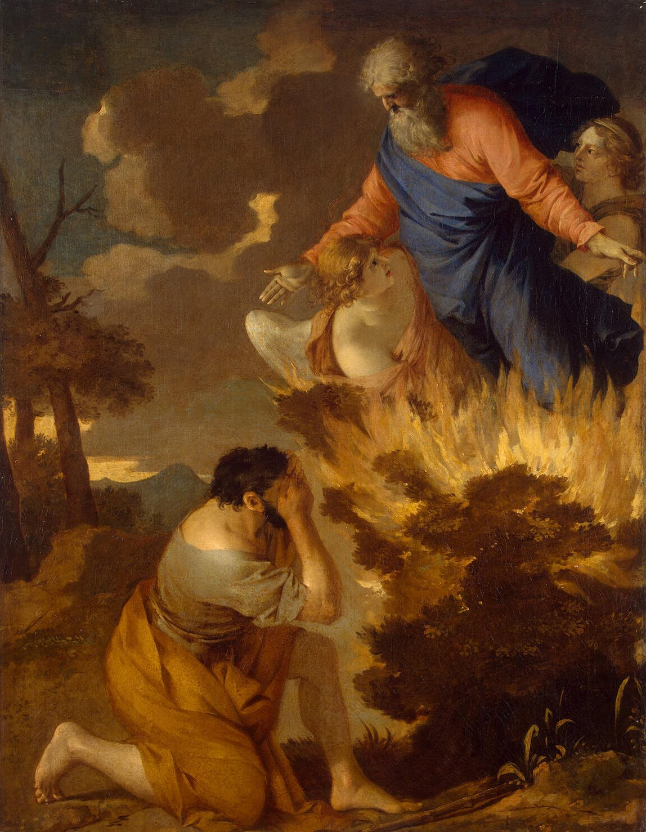
“ I have observed the misery of my people in Egypt; I have heard their cry. Indeed I know their sufferings and have come down to deliver them from the Egyptians, and to bring them out of that land to a good land flowing with milk and honey….. So come, I will send you to Pharaoh to bring my people, the Israelites out of Egypt” (Ex.3:7-10).

Slide 9
Mission of moses
“ You tell the children of Israel that the Lord, God of your fathers Abraham, Isaac and Jacob has sent me to you” (Ex. 3:13).
The message to the Israel was: “ God will save them from slavery in Egypt and lead them to a land flowing with milk and honey”.
The message for the pharaoh was: “Release the people of Israel so that they can go to a wilderness on a three- days journey where they can offer sacrifice to the Lord God”.

Slide 10
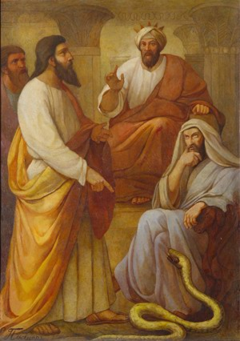
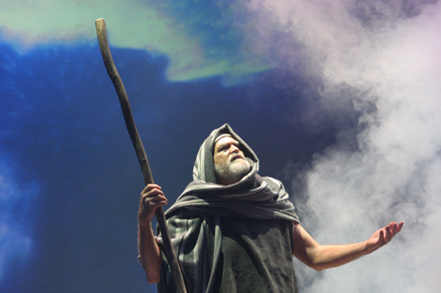
Three signs
“ They won’t believe me or listen to me They would say that the Lord has not appeared to me”. (Ex. 4:1).
God gave the following three signs to Moses to make him feel powerful: God asked Moses to throw his staff on the ground, and when he did so the staff turned into a snake. When Moses stepped back in fear God asked him to catch that snake by its tail. When he did so it turned back into the staff.

Slide 11
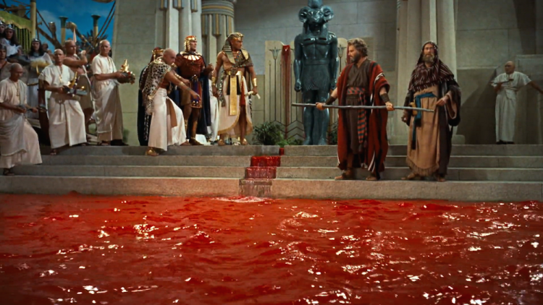
God gave Moses a third sign to be used if the people of Israel did not believe the first two signs. God said: Take some water from the river and pour it on the land It will turn into blood (Ex. 4:9).

Slide 12
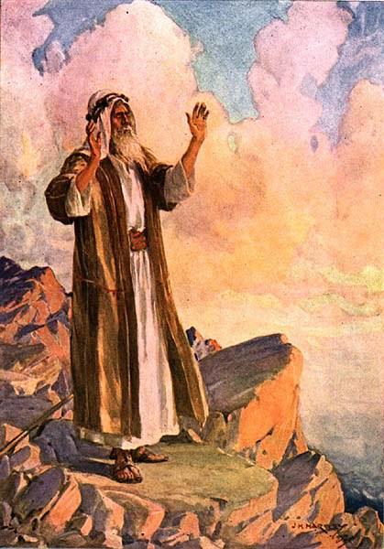
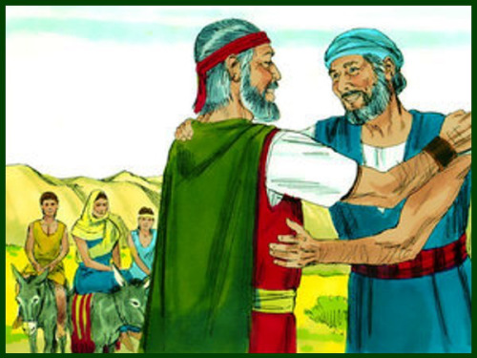
Aaron to assist
Even after all this Moses was still scared. He said to the Lord: “ O my Lord, I have never been eloquest…. I am slow of speech and slow of tongue” (Ex. 4:10-12). Moses requested the Lord to send someone very fluent in tongue in his place. So God gave Moses his own brother Aaron to assist him. God promised that He would be with both of them strengthening them in their mission. He also gave Moses the power to work miracles with his staff.

Slide 13
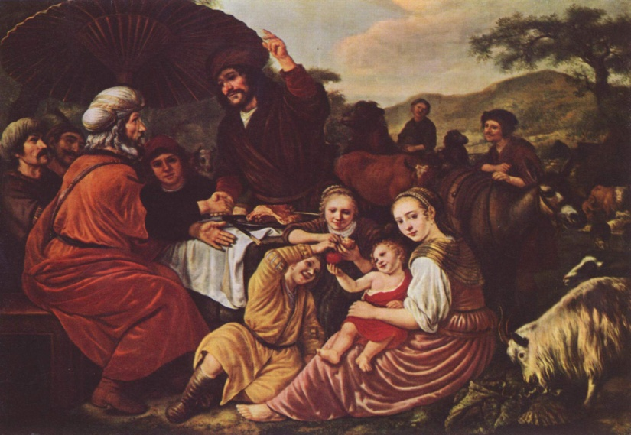
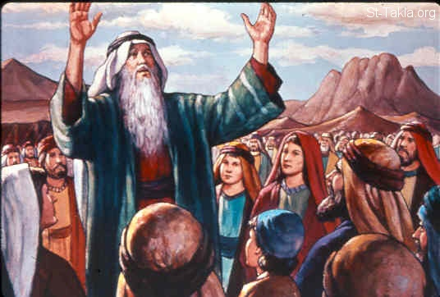
Mission to egypt
Taking leave of Jethro, Moses proceeded to Egypt with his wife and children God gave further instructions to Moses during this journey. He told Aaron: “You go towards the desert to meet Moses”. When they met, Moses explained to Aaron all that had happened. They assembled all the elders of Israel and explained all that God had told Moses. Moses also showed the signs before the people. They all believed and worshipped the Lord (Ex. 4:18-31).

Slide 14
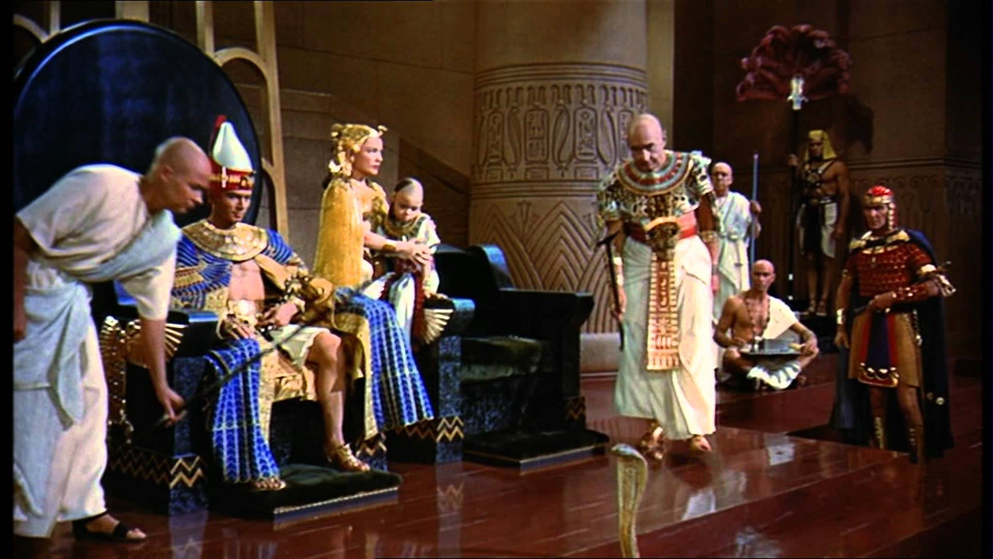
Before pharaoh
“Who is the Lord that I should heed Him and let Israel go? I will not know the Lord and I shall not let Israel go” (Ex. 5:2).
Moses took these problems to the Lord who encouraged him and said that things that He had told him would come to pass. The Lord also convinced Moses that Pharaoh world soon release the people of Israel.

Slide 15
Let us pray
O’ God Who selected Moses who had weaknesses, and appointed him for great things, help me also to overcome the weaknesses and helplessness of my life.

Slide 16
READ AND RECOUNT
Narrate the call of Moses by God
(Exodus 3:1-22)

Slide 17

WORD OF GOD FOR GUIDANCE
“ I will take you as my people and I will be your God” (Exodus 6:7).

Slide 18
MY DECISION
As Moses accepted the duties entrusted God, I will follow the directives of my parents.

Slide 19
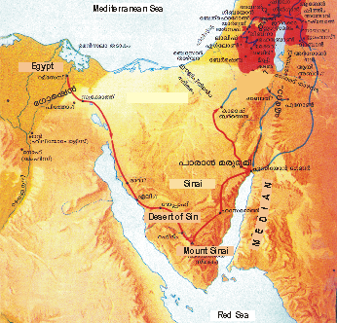
LET US DO
Point out the places given below on the map. Desert of sin, Median, Egypt.

Slide 20
LET US FIND OUT THE ANSWER
1. What is the meaning of the name, Moses?
2. Where did Moses have the vision of God?
3. What were the things God entrusted to Moses while wending to Pharaoh?
4. Whom did God give as a helper to Moses?
5. What is the message that the life history of Moses gives us?

Slide 21



Thank you

